Slide 1

H2HC
Isnaldo Francisco de Melo Jr
and Gabriel Alabarse

Slide 2
Software Tracing Comparison Using Data Mining Techniques
October 21st, 2017
École Polytechnique de Montréal
Laboratoire DORSAL

Slide 3

1
Outline
  -1.Jokes
  0. Definitions
1. Motivation
2. Background
  3. Problem definition
  4. Research Questions
  5. Data Model
  6. Methodology
7. Use Cases
  8. Discussion
  9. Threats to Validity
  10. Conclusion and Future Work
POLYTECHNIQUE MONTREAL – Francisco de Melo

Slide 4
2
-1. Jokes
  Poutine
  I was born in Diadema
  I actually lost my stick drive
POLYTECHNIQUE MONTREAL – Francisco de Melo

Slide 5
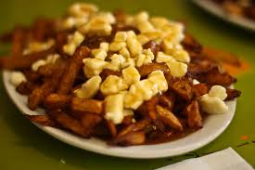
2
-1. Jokes
  Poutine
  Diadema
  I’m sorry/desole
  I actually lost my stick drive
POLYTECHNIQUE MONTREAL – Francisco de Melo

Slide 6
2
0. Definitions
  Regression tests
  Tracing and Profiling
  Root Cause Analysis
  Calling Context Trees*
POLYTECHNIQUE MONTREAL – Francisco de Melo

Slide 7
3
Context and Motivation
  Continuous Integration
  Regression tests in several builds
Performance evaluation
POLYTECHNIQUE MONTREAL – Francisco de Melo

Slide 8
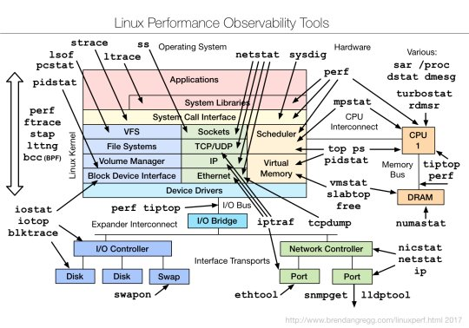
3
Context and Motivation 2
  Continuous Integration
  Regression tests in several builds
Performance evaluation
POLYTECHNIQUE MONTREAL – Francisco de Melo

Slide 9
5
2. Background
TraceCompare
TraceCompare: It is the framework proposed to compare
traces using the ECCT and the critical path. It shows the recorded metrics for a trained user to find the reason of this specific delay.
  Select groups of comparison manually
  Automation of the comparison task
POLYTECHNIQUE MONTREAL – Francisco de Melo

Slide 10
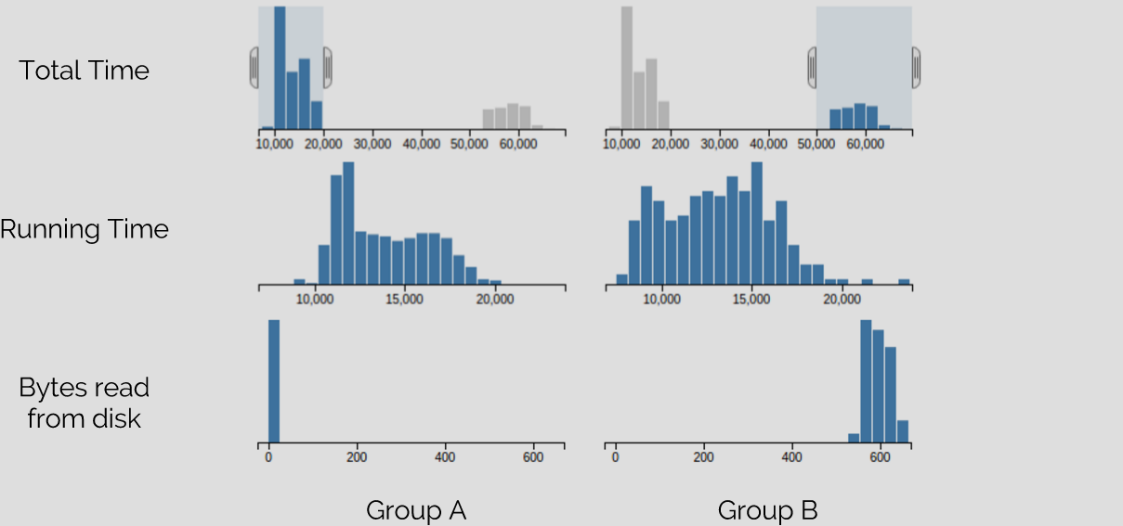
4
2. Background
TraceCompare
POLYTECHNIQUE MONTREAL – Francisco de Melo

Slide 11
6
2. Background
TraceCompare
  Select groups of comparison manually
  Manual comparison task
Only two groups of comparison
POLYTECHNIQUE MONTREAL – Francisco de Melo

Slide 12
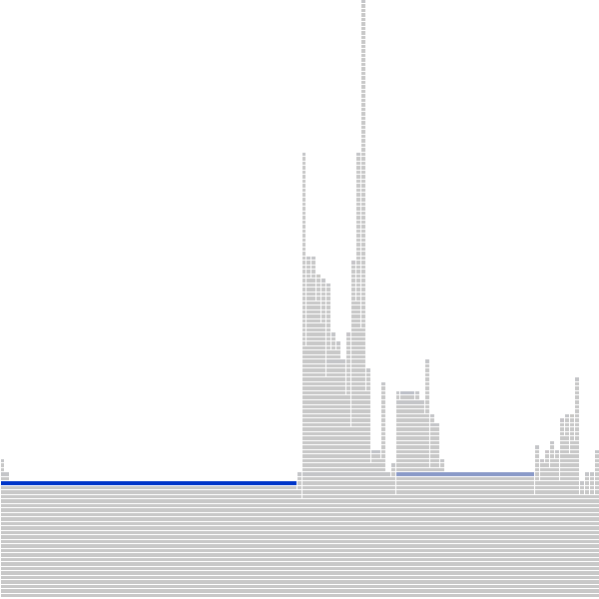
7
2. Background
Trevis
  Visualization tool
  CCTs
Several Mathematical applications
POLYTECHNIQUE MONTREAL – Francisco de Melo

Slide 13
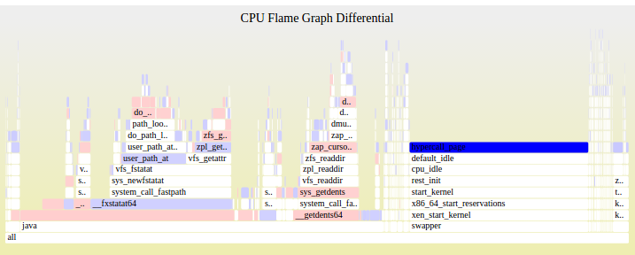
8
2. Background
Differential Flame Graph
  Comparative visualization tool
  CCTs
Several Mathematical applications
POLYTECHNIQUE MONTREAL – Francisco de Melo

Slide 14
9
3. Problem definition
Compare several executions of the same software
The current tools are limited to compare several executions of the same software or require human analysis to find root cause problems.
POLYTECHNIQUE MONTREAL – Francisco de Melo
Notes:
With latest techniques and work of pioneers, we have achieved very high tracing speeds and minimum overhead – well and good
But adding more features, newer techniques will drag down the desired performance of tracers
My goal is to attack those underlying techniques and algorithms so that tracers become future and feature ready and have uniformity
JIT really improvesJIT only when necessary – method or trace
Explore opportunities for optimizing – like specializing bytecode or improve JITing techniques
Like determine instruction type, using specialized instructions. Similar to LuaJIT

Slide 15
10
4. Research Questions
3.1 Hypothesis
Is it possible to find useful information by analyzing segments
of traces from calling context trees?
3.2 Methodology
Which methods can be used to do this process?
3.3 Assumptions
1. The groupings help uncover the causes for differences
2. Only the properties within the groups explain the differences
POLYTECHNIQUE MONTREAL – Francisco de Melo
Notes:
With latest techniques and work of pioneers, we have achieved very high tracing speeds and minimum overhead – well and good
But adding more features, newer techniques will drag down the desired performance of tracers
My goal is to attack those underlying techniques and algorithms so that tracers become future and feature ready and have uniformity
JIT really improvesJIT only when necessary – method or trace
Explore opportunities for optimizing – like specializing bytecode or improve JITing techniques
Like determine instruction type, using specialized instructions. Similar to LuaJIT

Slide 16
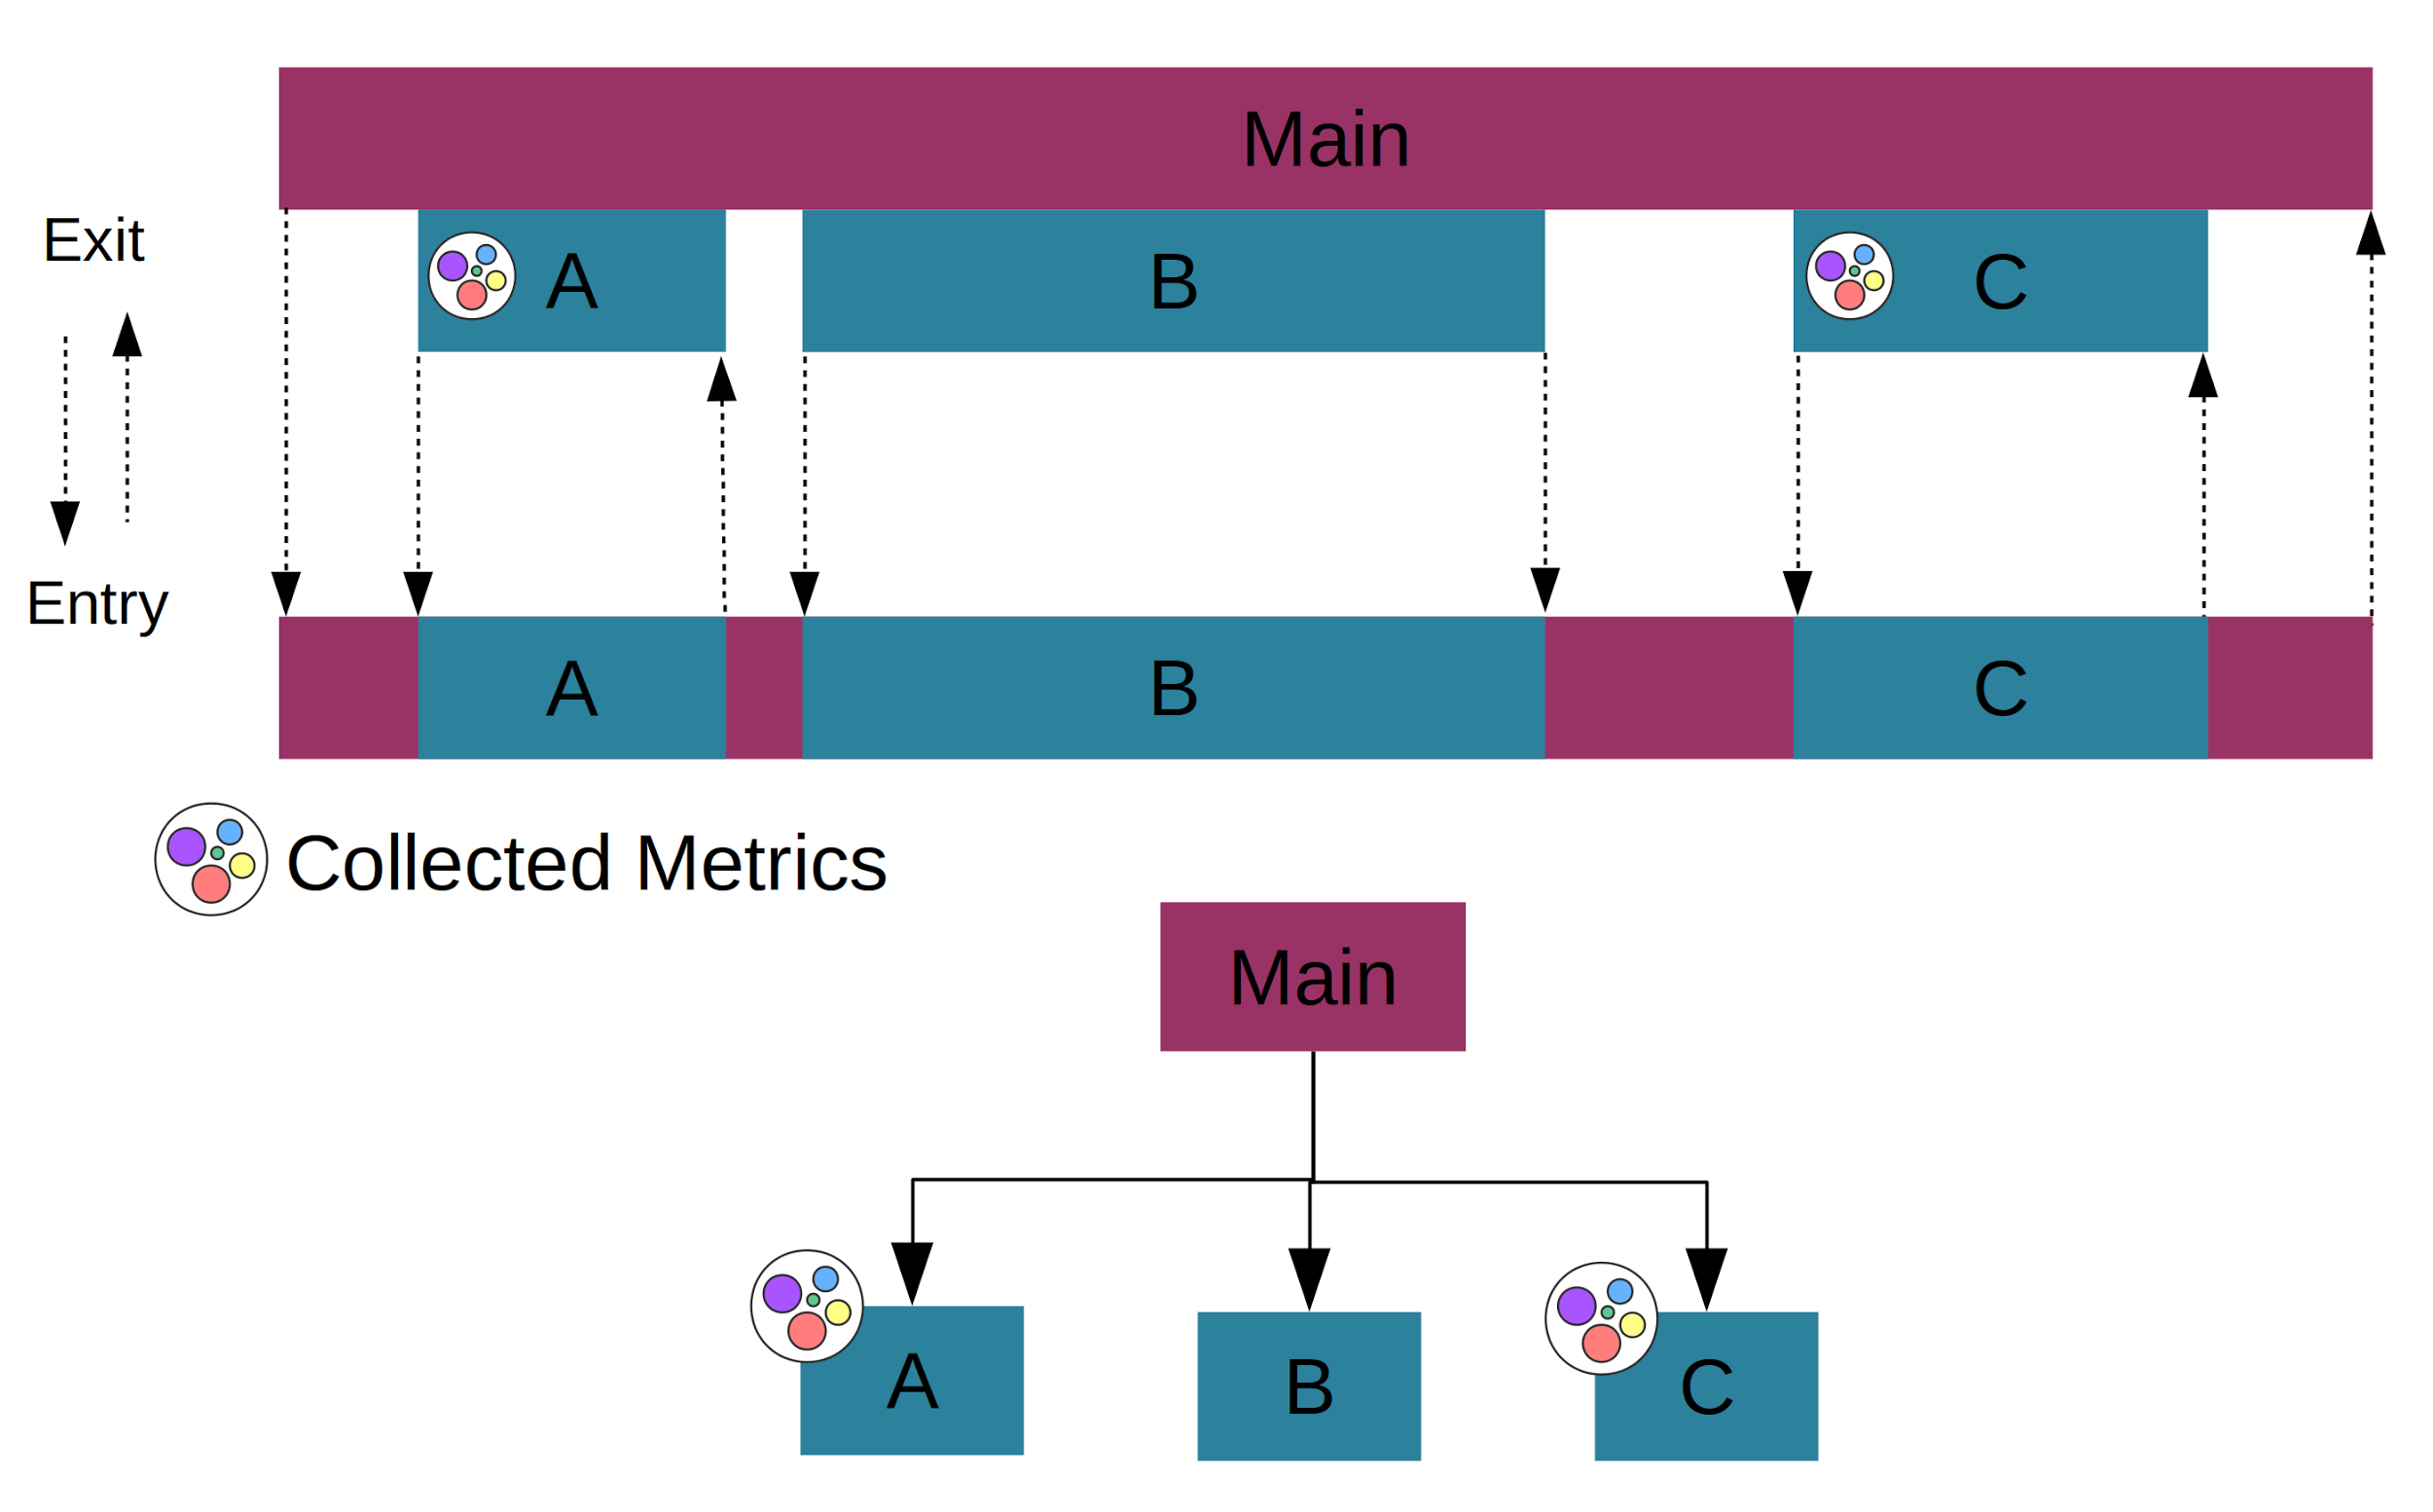
5. Data Model
11
Calling Context Model
Construction of tree using lttng and walking technique
POLYTECHNIQUE MONTREAL – Francisco de Melo
Notes:
With latest techniques and work of pioneers, we have achieved very high tracing speeds and minimum overhead – well and good
But adding more features, newer techniques will drag down the desired performance of tracers
My goal is to attack those underlying techniques and algorithms so that tracers become future and feature ready and have uniformity
JIT really improvesJIT only when necessary – method or trace
Explore opportunities for optimizing – like specializing bytecode or improve JITing techniques
Like determine instruction type, using specialized instructions. Similar to LuaJIT

Slide 17
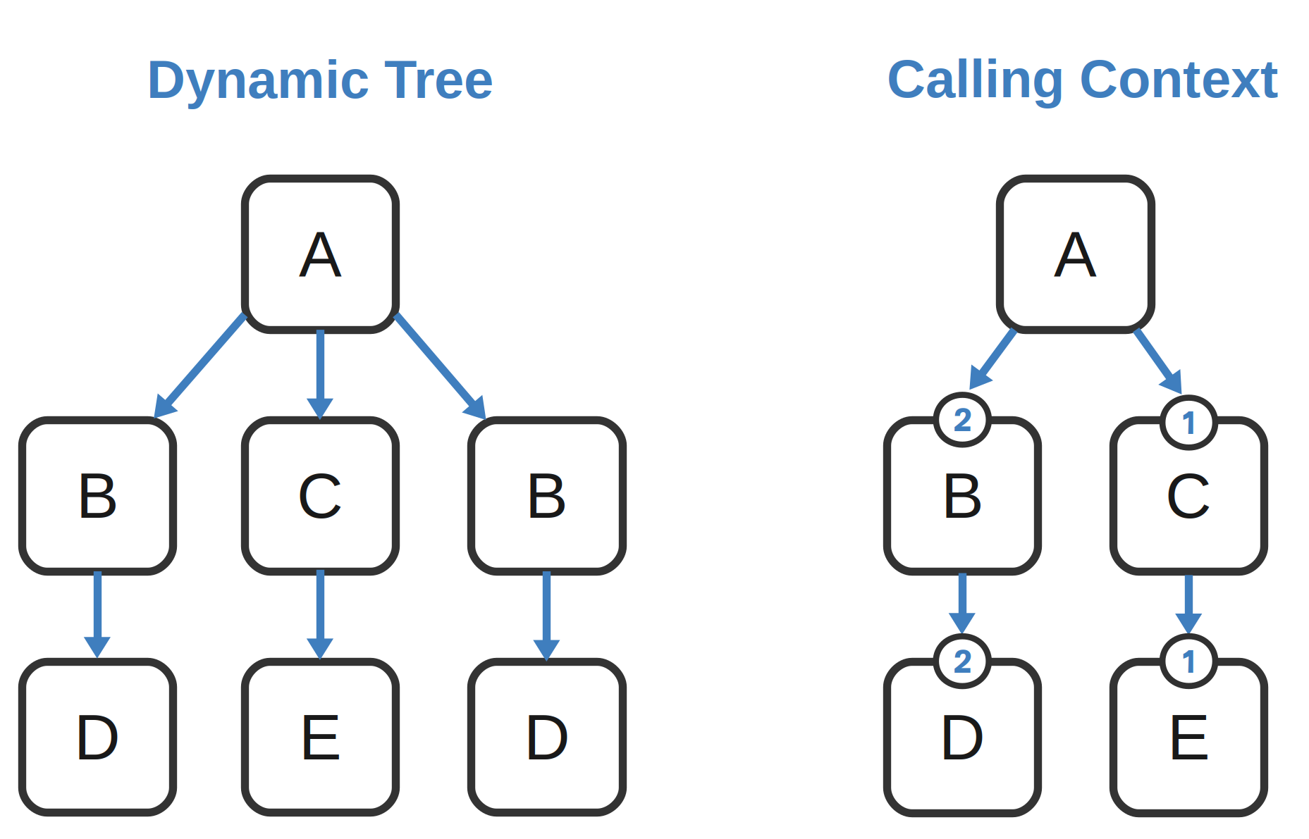
5. Data Model
12
POLYTECHNIQUE MONTREAL – Francisco de Melo
Notes:
With latest techniques and work of pioneers, we have achieved very high tracing speeds and minimum overhead – well and good
But adding more features, newer techniques will drag down the desired performance of tracers
My goal is to attack those underlying techniques and algorithms so that tracers become future and feature ready and have uniformity
JIT really improvesJIT only when necessary – method or trace
Explore opportunities for optimizing – like specializing bytecode or improve JITing techniques
Like determine instruction type, using specialized instructions. Similar to LuaJIT

Slide 18
6. Methodology
13
Overview
● Instrument the code
● Run the software
● Create the tree
● Apply the classification methods
● Compare the groups
POLYTECHNIQUE MONTREAL – Francisco de Melo
Notes:
With latest techniques and work of pioneers, we have achieved very high tracing speeds and minimum overhead – well and good
But adding more features, newer techniques will drag down the desired performance of tracers
My goal is to attack those underlying techniques and algorithms so that tracers become future and feature ready and have uniformity
JIT really improvesJIT only when necessary – method or trace
Explore opportunities for optimizing – like specializing bytecode or improve JITing techniques
Like determine instruction type, using specialized instructions. Similar to LuaJIT

Slide 19
6.1 Methodology - Instrumentation
14
Instrument the source code
This will enable recording profiling data which will then be saved together with each function
LTTng and Perf Tools
Metrics = instructions, page faults, cache misses
Linear output
POLYTECHNIQUE MONTREAL – Francisco de Melo
Notes:
With latest techniques and work of pioneers, we have achieved very high tracing speeds and minimum overhead – well and good
But adding more features, newer techniques will drag down the desired performance of tracers
My goal is to attack those underlying techniques and algorithms so that tracers become future and feature ready and have uniformity
JIT really improvesJIT only when necessary – method or trace
Explore opportunities for optimizing – like specializing bytecode or improve JITing techniques
Like determine instruction type, using specialized instructions. Similar to LuaJIT

Slide 20
6.2 Methodology - Analyzing the data
15
6.2 Classification
6.2.1 Classifying a set of metrics by using a non-supervised method (e.g. k-means and elbow method)
6.2.2 Analysis of the classification
6.2.3 Use the result to deduce the root cause
POLYTECHNIQUE MONTREAL – Francisco de Melo
Notes:
With latest techniques and work of pioneers, we have achieved very high tracing speeds and minimum overhead – well and good
But adding more features, newer techniques will drag down the desired performance of tracers
My goal is to attack those underlying techniques and algorithms so that tracers become future and feature ready and have uniformity
JIT really improvesJIT only when necessary – method or trace
Explore opportunities for optimizing – like specializing bytecode or improve JITing techniques
Like determine instruction type, using specialized instructions. Similar to LuaJIT

Slide 21
6.3 Methodology - Mining Techniques
16
Presentation of two techniques
SVM
k-means (elbow heuristic)
POLYTECHNIQUE MONTREAL – Francisco de Melo
Notes:
With latest techniques and work of pioneers, we have achieved very high tracing speeds and minimum overhead – well and good
But adding more features, newer techniques will drag down the desired performance of tracers
My goal is to attack those underlying techniques and algorithms so that tracers become future and feature ready and have uniformity
JIT really improvesJIT only when necessary – method or trace
Explore opportunities for optimizing – like specializing bytecode or improve JITing techniques
Like determine instruction type, using specialized instructions. Similar to LuaJIT

Slide 22
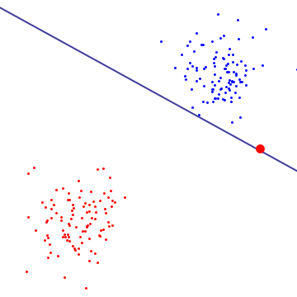
6.3 Methodology - Techniques
17
Support Vector Machine
Classify the data using an hyperplane
Supervised
Drawbacks
POLYTECHNIQUE MONTREAL – Francisco de Melo
Notes:
With latest techniques and work of pioneers, we have achieved very high tracing speeds and minimum overhead – well and good
But adding more features, newer techniques will drag down the desired performance of tracers
My goal is to attack those underlying techniques and algorithms so that tracers become future and feature ready and have uniformity
JIT really improvesJIT only when necessary – method or trace
Explore opportunities for optimizing – like specializing bytecode or improve JITing techniques
Like determine instruction type, using specialized instructions. Similar to LuaJIT

Slide 23
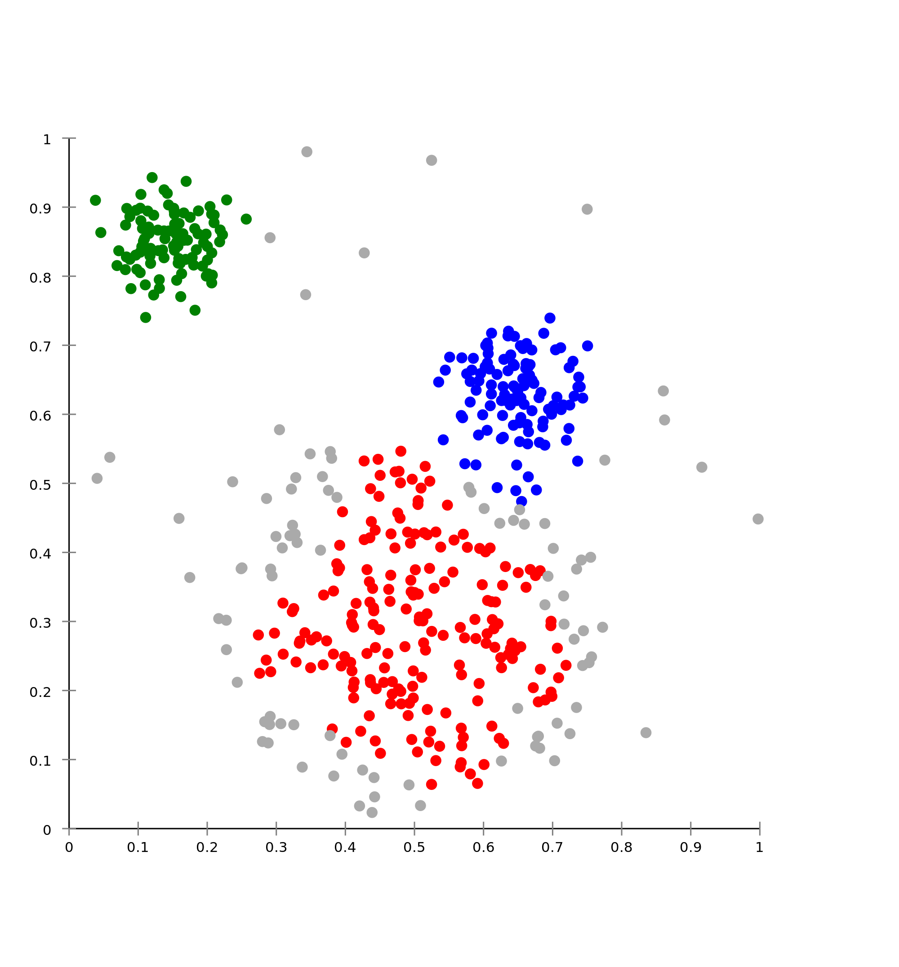
6.3.1 Methodology - Techniques
18
k-means (elbow heuristic)
Unsupervised
k is pre-defined
optimal division in k clusters
POLYTECHNIQUE MONTREAL – Francisco de Melo
Notes:
With latest techniques and work of pioneers, we have achieved very high tracing speeds and minimum overhead – well and good
But adding more features, newer techniques will drag down the desired performance of tracers
My goal is to attack those underlying techniques and algorithms so that tracers become future and feature ready and have uniformity
JIT really improvesJIT only when necessary – method or trace
Explore opportunities for optimizing – like specializing bytecode or improve JITing techniques
Like determine instruction type, using specialized instructions. Similar to LuaJIT

Slide 24
6.3.2 Methodology - Techniques
19
Elbow heuristic
Find the best k
Compare SSE
Comparison: find the biggest gap → starting from 2
POLYTECHNIQUE MONTREAL – Francisco de Melo
Notes:
With latest techniques and work of pioneers, we have achieved very high tracing speeds and minimum overhead – well and good
But adding more features, newer techniques will drag down the desired performance of tracers
My goal is to attack those underlying techniques and algorithms so that tracers become future and feature ready and have uniformity
JIT really improvesJIT only when necessary – method or trace
Explore opportunities for optimizing – like specializing bytecode or improve JITing techniques
Like determine instruction type, using specialized instructions. Similar to LuaJIT

Slide 25
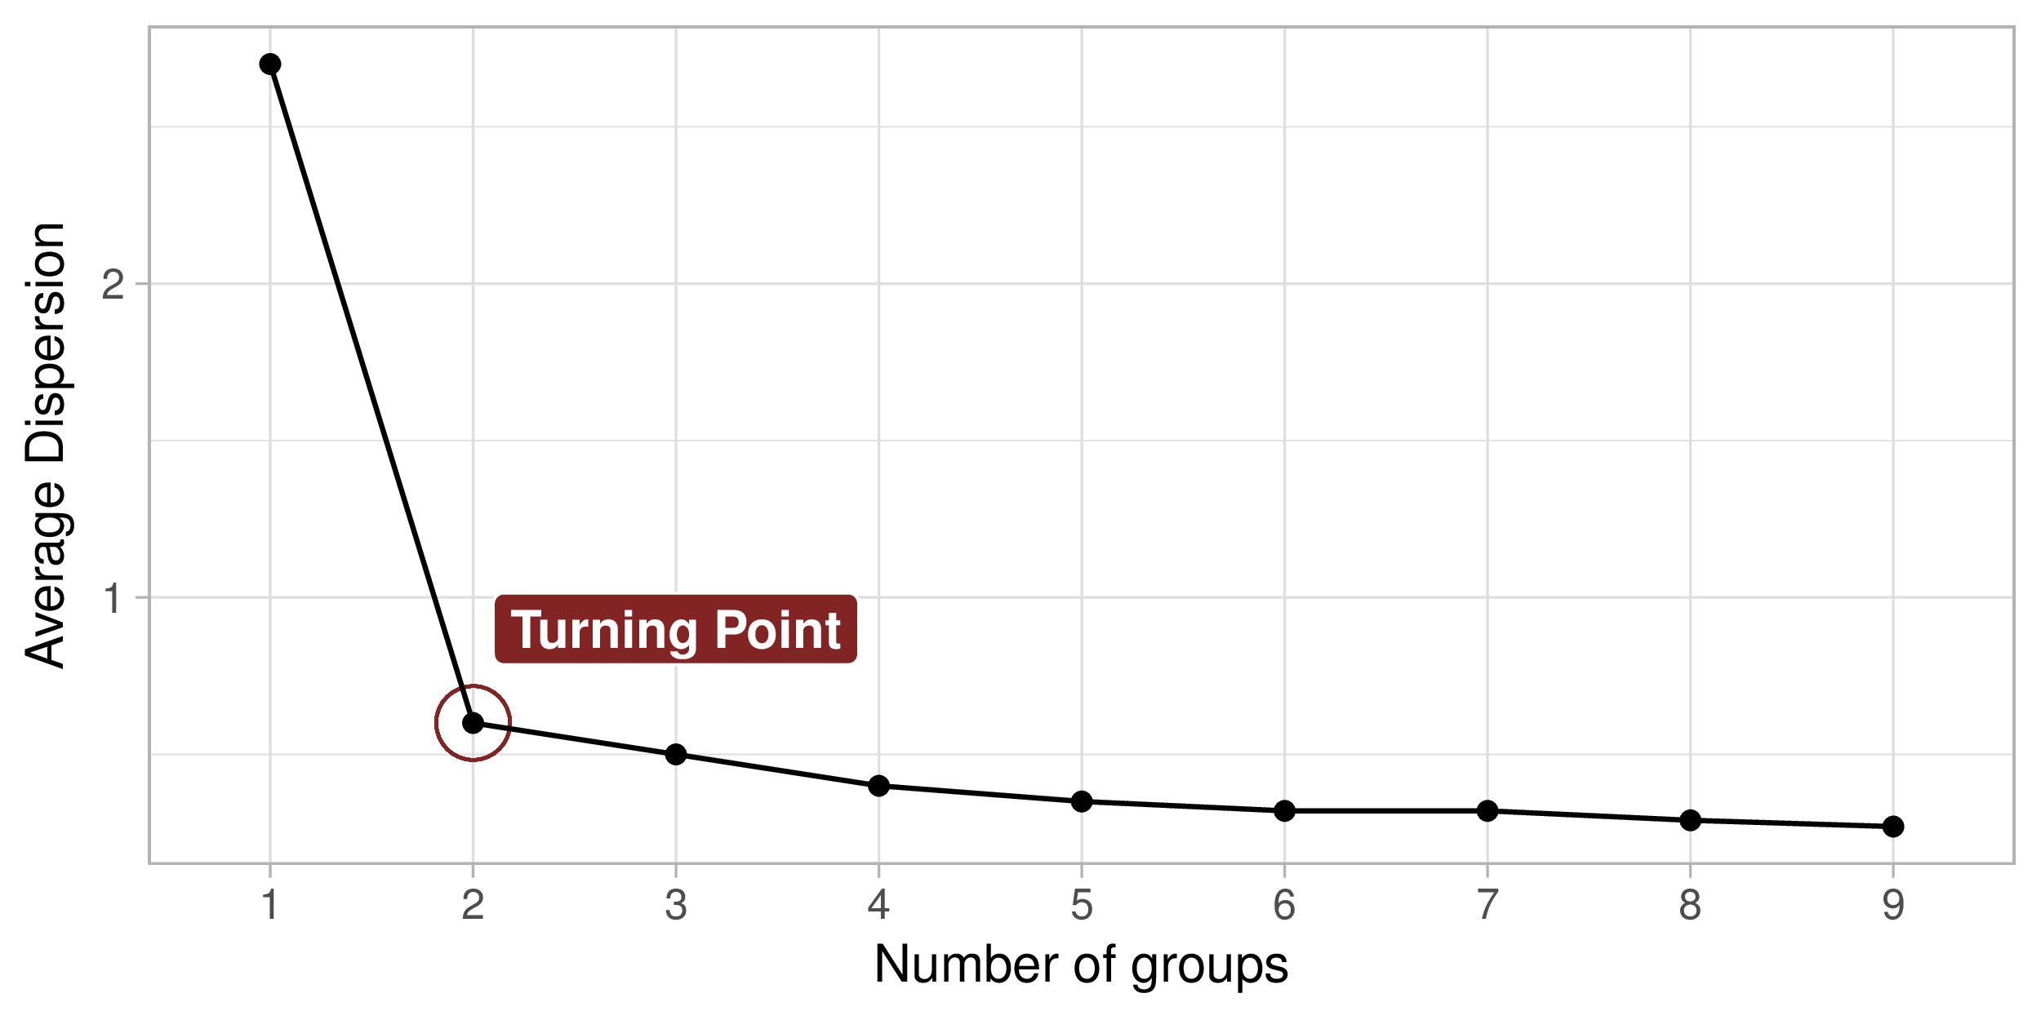
6.3.2 Methodology - Techniques
20
Elbow heuristic
Find the best k
Compare SSE
POLYTECHNIQUE MONTREAL – Francisco de Melo
Notes:
With latest techniques and work of pioneers, we have achieved very high tracing speeds and minimum overhead – well and good
But adding more features, newer techniques will drag down the desired performance of tracers
My goal is to attack those underlying techniques and algorithms so that tracers become future and feature ready and have uniformity
JIT really improvesJIT only when necessary – method or trace
Explore opportunities for optimizing – like specializing bytecode or improve JITing techniques
Like determine instruction type, using specialized instructions. Similar to LuaJIT

Slide 26
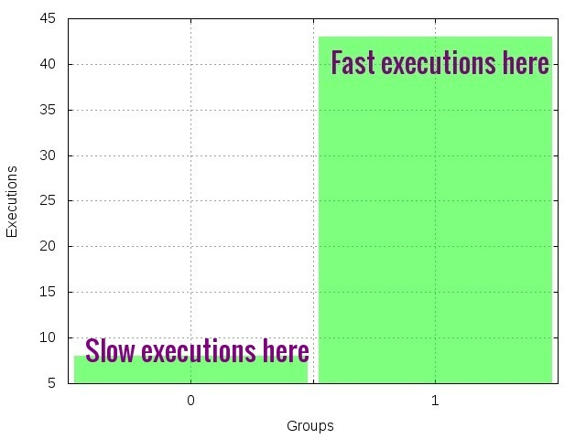
6.4 Methodology - Example
21
Workload cache misses
POLYTECHNIQUE MONTREAL – Francisco de Melo
Notes:
With latest techniques and work of pioneers, we have achieved very high tracing speeds and minimum overhead – well and good
But adding more features, newer techniques will drag down the desired performance of tracers
My goal is to attack those underlying techniques and algorithms so that tracers become future and feature ready and have uniformity
JIT really improvesJIT only when necessary – method or trace
Explore opportunities for optimizing – like specializing bytecode or improve JITing techniques
Like determine instruction type, using specialized instructions. Similar to LuaJIT

Slide 27
7. Use Cases
22
Presentation of three use cases
Inline
OpenCV
Cache Optimization
POLYTECHNIQUE MONTREAL – Francisco de Melo
Notes:
With latest techniques and work of pioneers, we have achieved very high tracing speeds and minimum overhead – well and good
But adding more features, newer techniques will drag down the desired performance of tracers
My goal is to attack those underlying techniques and algorithms so that tracers become future and feature ready and have uniformity
JIT really improvesJIT only when necessary – method or trace
Explore opportunities for optimizing – like specializing bytecode or improve JITing techniques
Like determine instruction type, using specialized instructions. Similar to LuaJIT

Slide 28
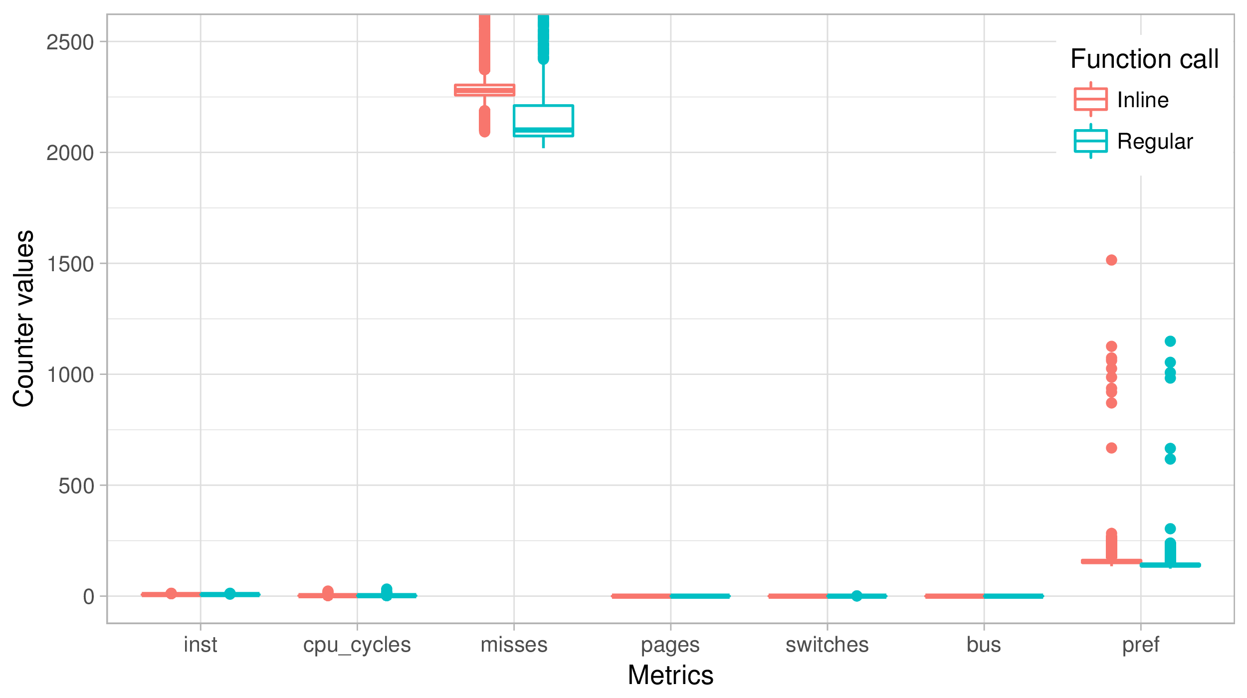
7.1 Use Case 1
23
USE CASE 1 - Inline
POLYTECHNIQUE MONTREAL – Francisco de Melo
Notes:
With latest techniques and work of pioneers, we have achieved very high tracing speeds and minimum overhead – well and good
But adding more features, newer techniques will drag down the desired performance of tracers
My goal is to attack those underlying techniques and algorithms so that tracers become future and feature ready and have uniformity
JIT really improvesJIT only when necessary – method or trace
Explore opportunities for optimizing – like specializing bytecode or improve JITing techniques
Like determine instruction type, using specialized instructions. Similar to LuaJIT

Slide 29
7.2 Use Case 2
24
USE CASE 2 - OpenCV
Optical Flow
Instructions difference on the groups
R correlation might not be used
POLYTECHNIQUE MONTREAL – Francisco de Melo
Notes:
With latest techniques and work of pioneers, we have achieved very high tracing speeds and minimum overhead – well and good
But adding more features, newer techniques will drag down the desired performance of tracers
My goal is to attack those underlying techniques and algorithms so that tracers become future and feature ready and have uniformity
JIT really improvesJIT only when necessary – method or trace
Explore opportunities for optimizing – like specializing bytecode or improve JITing techniques
Like determine instruction type, using specialized instructions. Similar to LuaJIT

Slide 30
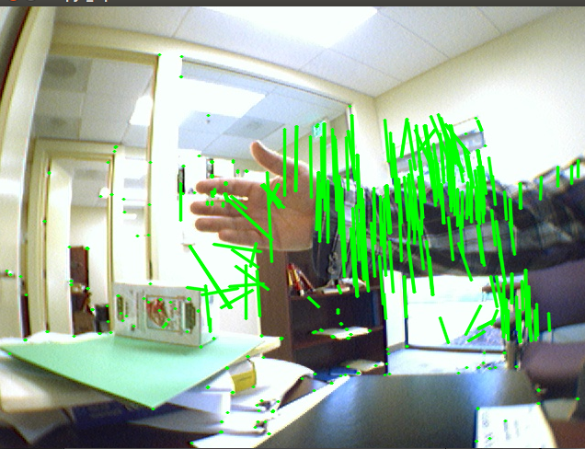
7.2 Use Case 2
24
POLYTECHNIQUE MONTREAL – Francisco de Melo
Notes:
With latest techniques and work of pioneers, we have achieved very high tracing speeds and minimum overhead – well and good
But adding more features, newer techniques will drag down the desired performance of tracers
My goal is to attack those underlying techniques and algorithms so that tracers become future and feature ready and have uniformity
JIT really improvesJIT only when necessary – method or trace
Explore opportunities for optimizing – like specializing bytecode or improve JITing techniques
Like determine instruction type, using specialized instructions. Similar to LuaJIT

Slide 31
7.3 Use Case 3
25
USE CASE 3 - Cache Optimization
Php Requests
After several executions, the performance decreased
Periodic problem
POLYTECHNIQUE MONTREAL – Francisco de Melo
Notes:
With latest techniques and work of pioneers, we have achieved very high tracing speeds and minimum overhead – well and good
But adding more features, newer techniques will drag down the desired performance of tracers
My goal is to attack those underlying techniques and algorithms so that tracers become future and feature ready and have uniformity
JIT really improvesJIT only when necessary – method or trace
Explore opportunities for optimizing – like specializing bytecode or improve JITing techniques
Like determine instruction type, using specialized instructions. Similar to LuaJIT

Slide 32
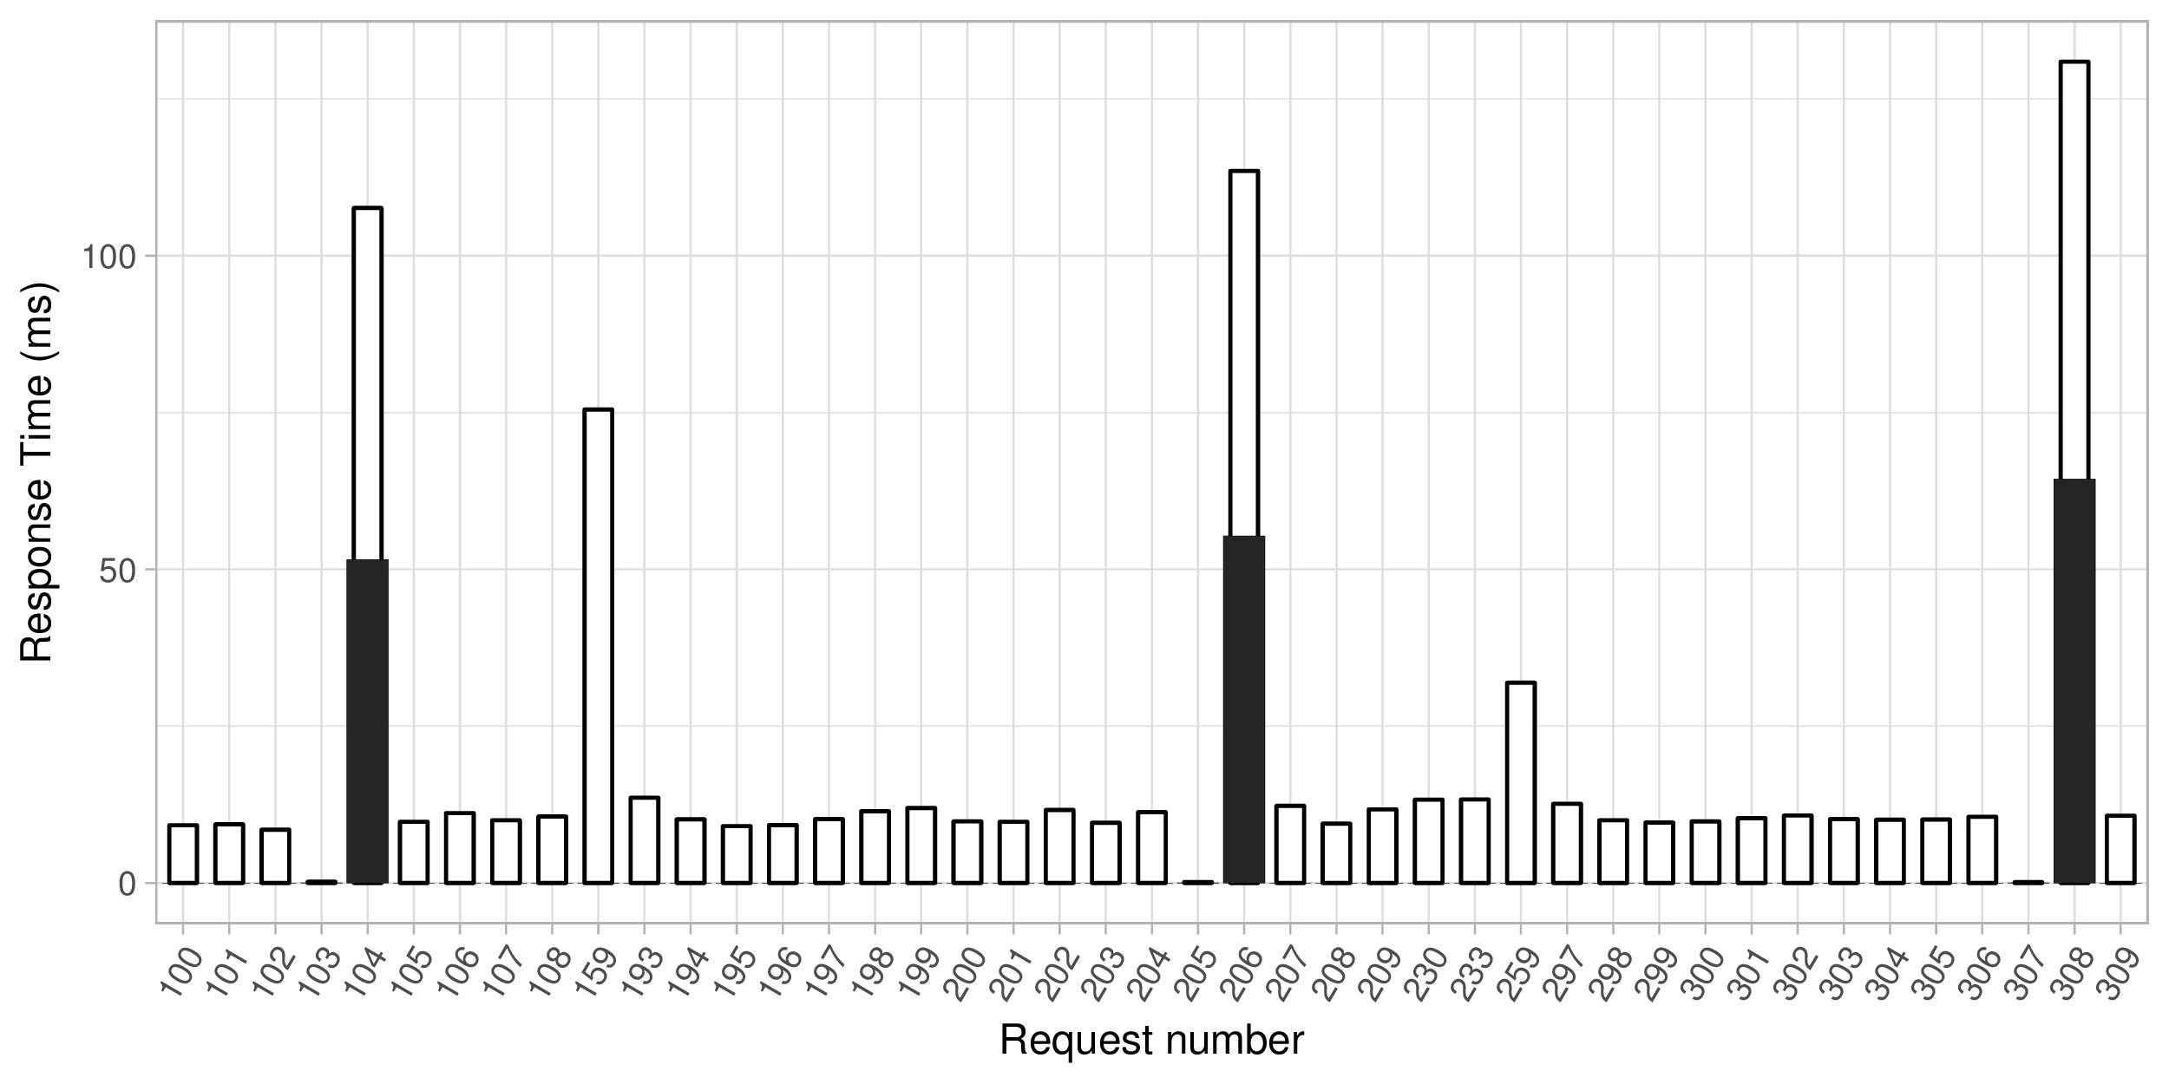
7.3 Use Case 3
25
USE CASE 3 - Cache Optimization
POLYTECHNIQUE MONTREAL – Francisco de Melo
Notes:
With latest techniques and work of pioneers, we have achieved very high tracing speeds and minimum overhead – well and good
But adding more features, newer techniques will drag down the desired performance of tracers
My goal is to attack those underlying techniques and algorithms so that tracers become future and feature ready and have uniformity
JIT really improvesJIT only when necessary – method or trace
Explore opportunities for optimizing – like specializing bytecode or improve JITing techniques
Like determine instruction type, using specialized instructions. Similar to LuaJIT

Slide 33
26
8. Discussion
SVM will require a label phase
The kernels of classification can lead to misclassification
Soft classification cannot necessarily help, since a probabilistic
classification can make the performance evaluation more difficult
POLYTECHNIQUE MONTREAL – Francisco de Melo

Slide 34
9. Threats to Validity
27
Only for UST
Instrumentation required
Source code comparison is still required
Assumptions must be considered
POLYTECHNIQUE MONTREAL – Francisco de Melo

Slide 35
10.1 Conclusion
28
The differences on each group can indicate normal performance variations but also can highlight abnormal metric variations
Knowing the abnormal metric and with some knowledge of the source code, it is possible to find performance regressions
POLYTECHNIQUE MONTREAL – Francisco de Melo

Slide 36
10.1 Conclusion
29
Answers to the research questions
Methods evaluation
POLYTECHNIQUE MONTREAL – Francisco de Melo

Slide 37
10. 2 Future work
30
Use other techniques
Combination of techniques
Automate the whole process - including source code comparison
Merge with group comparison techniques
POLYTECHNIQUE MONTREAL – Francisco de Melo

Slide 38

Questions
isnaldo-francisco.de-melo-jr@polymtl.ca
Any other info?
31
POLYTECHNIQUE MONTREAL – Francisco de Melo

Slide 39
Merci
32
POLYTECHNIQUE MONTREAL – Francisco de Melo

Slide 40
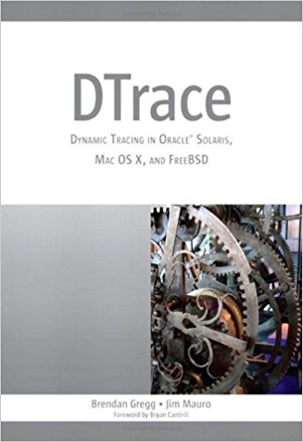
Want to learn more?
32
POLYTECHNIQUE MONTREAL – Francisco de Melo

Slide 41
Merci
32
POLYTECHNIQUE MONTREAL – Francisco de Melo

Slide 42
References
33
Doray, F, and M. R. Dagenais, "Diagnosing Performance Variations by Comparing Multi-Level Execution Traces", IEEE Transactions on Parallel and Distributed Systems, vol. pp,issue: 99 no. 1, 2016.
Andrea Adamoli and Matthias Hauswirth. Trevis: A context
tree visualization & analysis framework and its use for classifying
performance failure reports. In SoftVis ’10: Proceedings
of the ACM Symposium on Software Visualization, 2010.
J. M. Spivey. Fast, Accurate Call Graph Profiling. Softw.
Pract. Exper., 34(3):249–264, 2004.
W. N. Sumner, Y. Zheng, D. Weeratunge, and X. Zhang. Precise Calling
Context Encoding. In ACM International Conference on Software Engineering,
2010.
POLYTECHNIQUE MONTREAL – Francisco de Melo
Notes:
With latest techniques and work of pioneers, we have achieved very high tracing speeds and minimum overhead – well and good
But adding more features, newer techniques will drag down the desired performance of tracers
My goal is to attack those underlying techniques and algorithms so that tracers become future and feature ready and have uniformity
JIT really improvesJIT only when necessary – method or trace
Explore opportunities for optimizing – like specializing bytecode or improve JITing techniques
Like determine instruction type, using specialized instructions. Similar to LuaJIT

